Slide 1
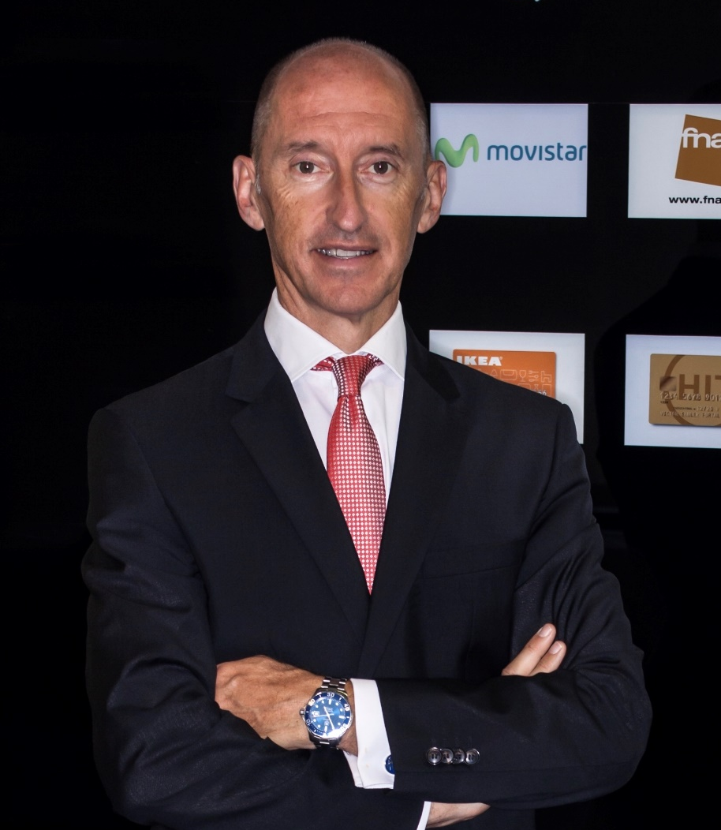
François Miqueu
  30+ years international experience in consumer & retail banking
François Miqueu has an MBA from HEC (Paris, France). After 30 years of international career in banking and financial services in France, USA and Spain, including 20 years as Chief Executive Officer, he is devoting himself since 2020 to boards as INED, business consulting and strategy lecturing.
He is Independent Non-Executive Director in the boards of directors of WiZink Bank (regulated consumer finance bank of Värde Partners in Spain & Portugal), of Autopay (regulated digital payments leader in Poland, participated by Pollen Street Capital), of Salafin (regulated & listed consumer finance entity of Bank of Africa in Morocco) and of Evollis (leader in the rental of electronic products in Europe, participated by BNPP). He also represents CaixaBank in the board of directors of BB Auto Finance (regulated automotive financing company in China, participated by CaixaBank & Bank of East Asia and partner of Tesla, Li Auto, Xiaomi & other Chinese NEVs OEMs).
He was from 2008 to 2019 Chief Executive Officer of CaixaBank Consumer Finance, leading the consumer & commercial credit activities of CaixaBank, creating 2 joint ventures with Telefonica in Spain & Bank of East Asia in China. He built the consumer activities of the bank turning CaixaBank in the #1 distributor of Samsung in Iberia and #1 reseller of cars in Spain, achieving strategic partnerships with large distributors (MediaMarkt, FNAC, IKEA…).
From 1999 to 2007, he was Chief Executive Officer of GE Money Bank Spain, where he developed the bank's position in Spain from 14th to 3rd place through strategic partnerships, mainly through alliances and joint ventures with 4 major Spanish banks and large distributors.
Previously, he worked in the USA for Citibank as director of marketing for retail banking and for American Express as director of marketing for banking and credit cards.
He is also a lecturer in strategy execution and change management at IESE Business School since 2001 and professor of strategy at MDE Business School.

